Slide 1
Fashion segmentation
Segmentation of fashion-related items

Slide 2
Agenda
Project overview
Segmentation Architectures
- Structure
- Pros and Cons
- Train process and time
- Results/Examples
Alternative Applications
Conclusions
Guidelines:
20 min + 5-10 mins for questions
Clear explanation of method or algorithm
Illustrative results
Text size 16+; large enough to read

Slide 3
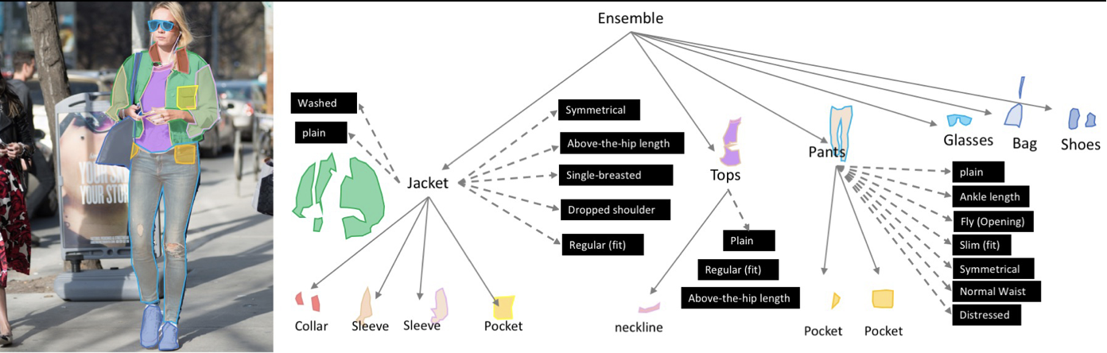
2019 Fashion Kaggle Competition
Objective: Segment clothing items and identify details and characteristics.
https://www.kaggle.com/c/imaterialist-fashion-2019-FGVC6/overview

Slide 4
Dataset
50k images
46 classes of fashion items
Image catalog containing image reference data and segmentation data
Pre-Processing
FashionDataset class created to standardize commonly needed functions
Image refences and labeled annotations loaded into instances for training and validation

Slide 5
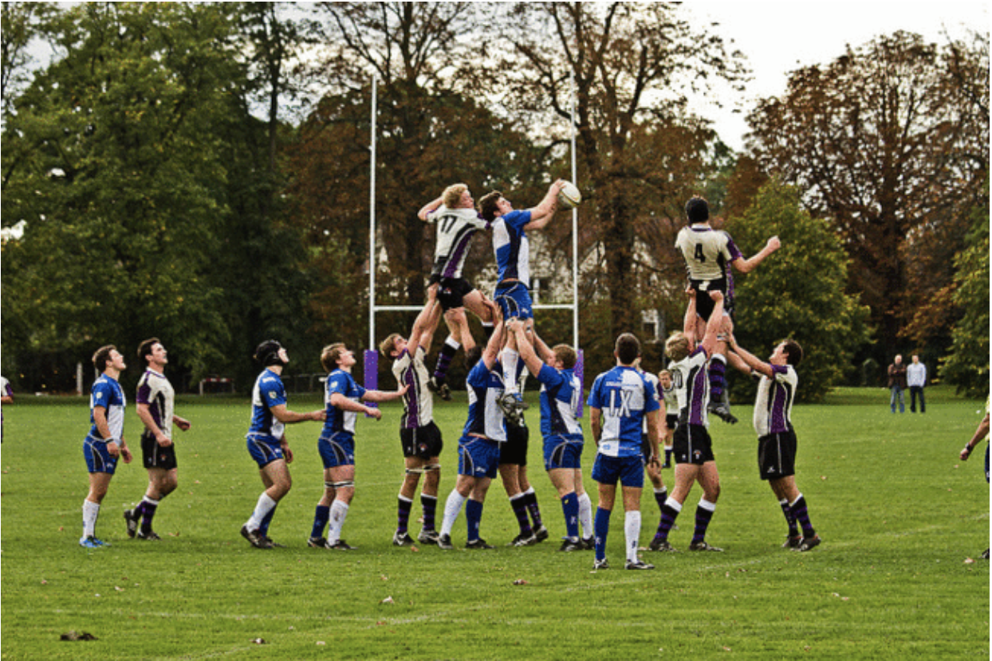
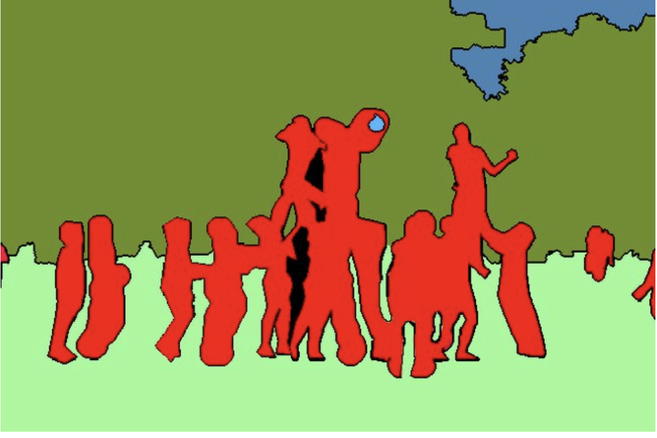
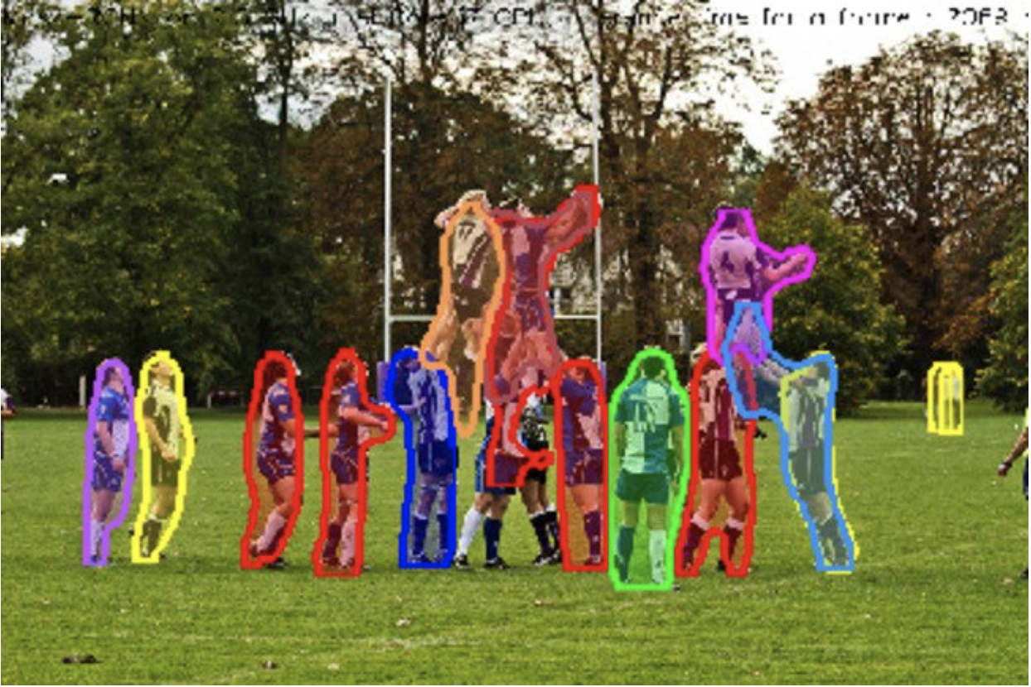
Segmentation Features/Types
Two main types of segmentation tasks
Fashion Segmentation will focus on instance segmentation
Semantic Segmentation - Recognition of classes in segmentation mask
Instance Segmentation - Separately identifies multiple instances of classes
https://divamgupta.com/image-segmentation/2019/06/06/deep-learning-semantic-segmentation-keras.html

Slide 6
Segmentation Architectures
Architecture | Characteristics
FCN | Simple datasets with small number of objects
Unet | Medical imaging Fine details
Mask R-CNN | Includes bounding boxes along with instance segmentation
PSPNet | Good with objects of varying sizes
Yolact | Real-time speeds

Slide 7
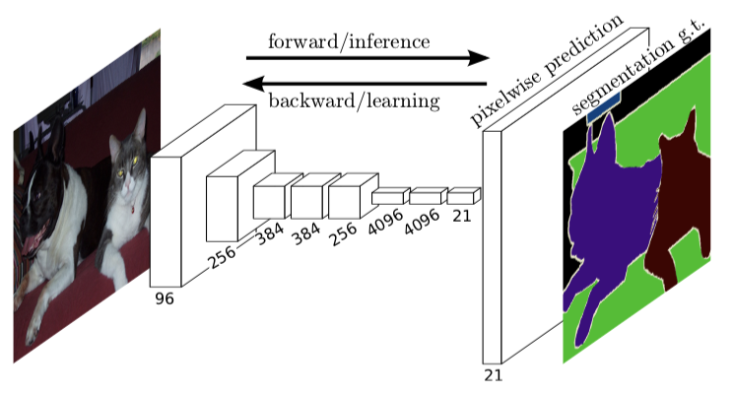
FCN (Fully Convolutional Network)
Early segmentation architecture
Uses CNN’s throughout
https://arxiv.org/pdf/1605.06211v1.pdf

Slide 8
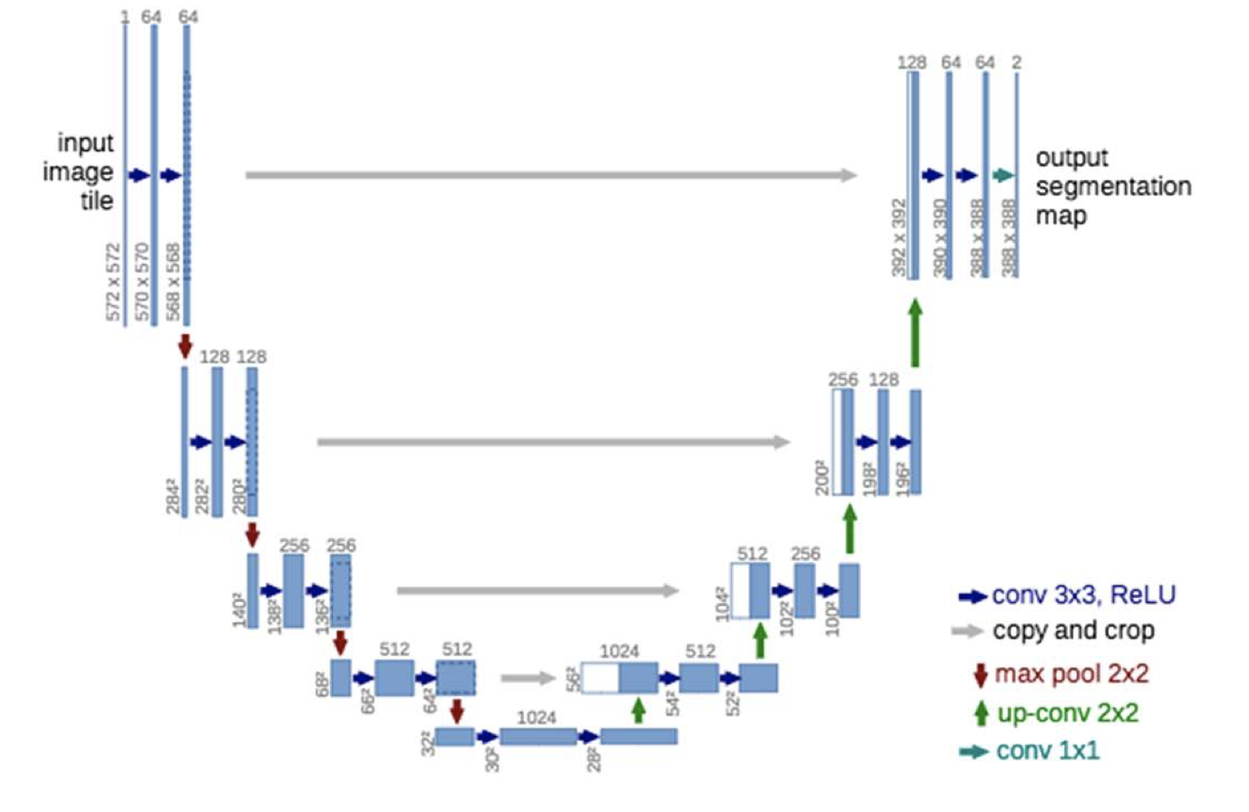
UNet
Uses skip connections to maintain detail in decoder
Used in medical imaging where detail is important
https://arxiv.org/pdf/1505.04597.pdf

Slide 9
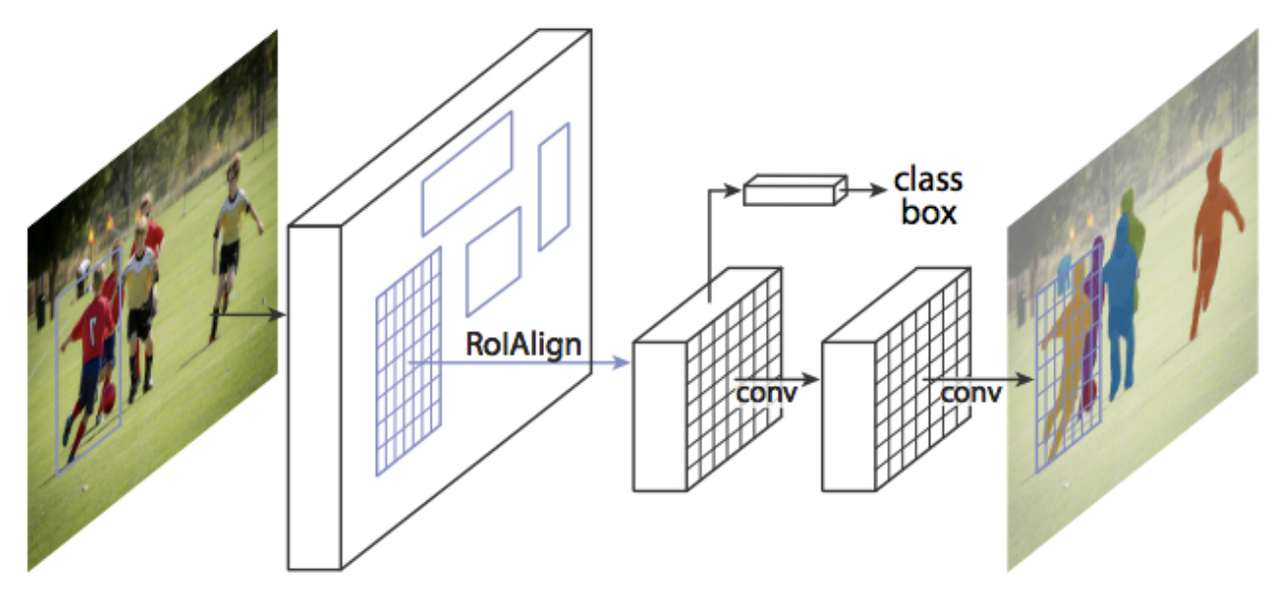
Mask R-CNN
Iteration of R-CNN evolution
Adds segmentation to previous iterations
Includes bounding boxes and instance segmentation
https://arxiv.org/pdf/1703.06870.pdf

Slide 10
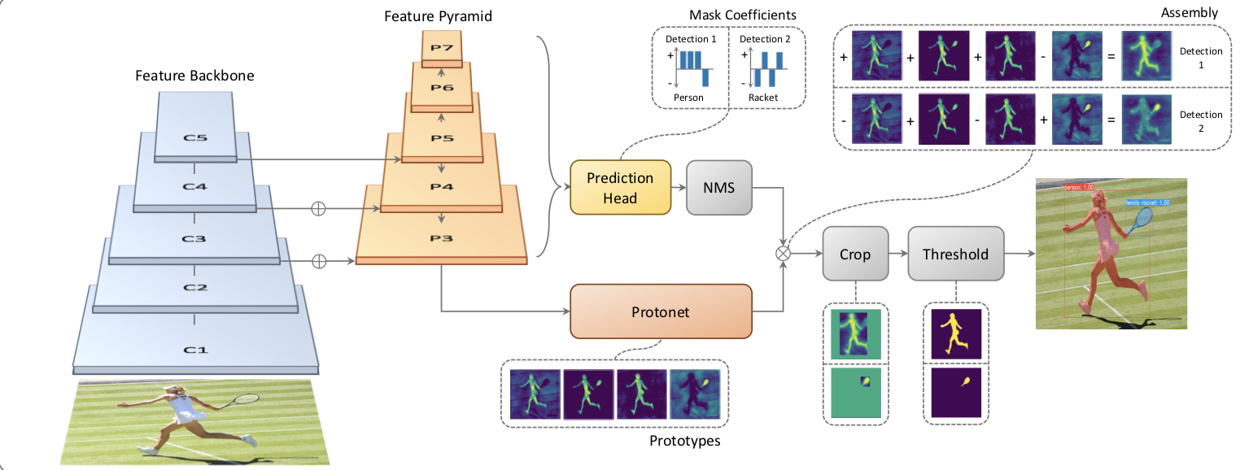
YOLACT
Real-time speeds
http://openaccess.thecvf.com/content_ICCV_2019/papers/Bolya_YOLACT_Real-Time_Instance_Segmentation_ICCV_2019_paper.pdf

Slide 11
Encoder Architecture
Most segmentation models use an encoder structure
Input:
image
Output: Mask
Encoding
Encoder
Decoder
Modularity:
A benefit of this structure is that the encoder and decoder portions can be separated.

Slide 12
Encoder Modularity Example
Build Steps:
Isolate Unet decoder
Import Resnet pretrained network
Connect Layers
Adjust Image scaling for training
Train
Adjust image scaling for inference
ResNet
Unet
Input
Block 1
uuuu
Block 2
uuuu
Block 3
uuuu
Block 4
uuuu
Block 5
Encoder
uuuu

